Slide 1



Ontario School Boards Visualizations
View in Power BI
Last data refresh:
2024-06-21 11:23:57 AM UTC
Downloaded at:
2024-06-21 7:16:54 PM UTC

Slide 2
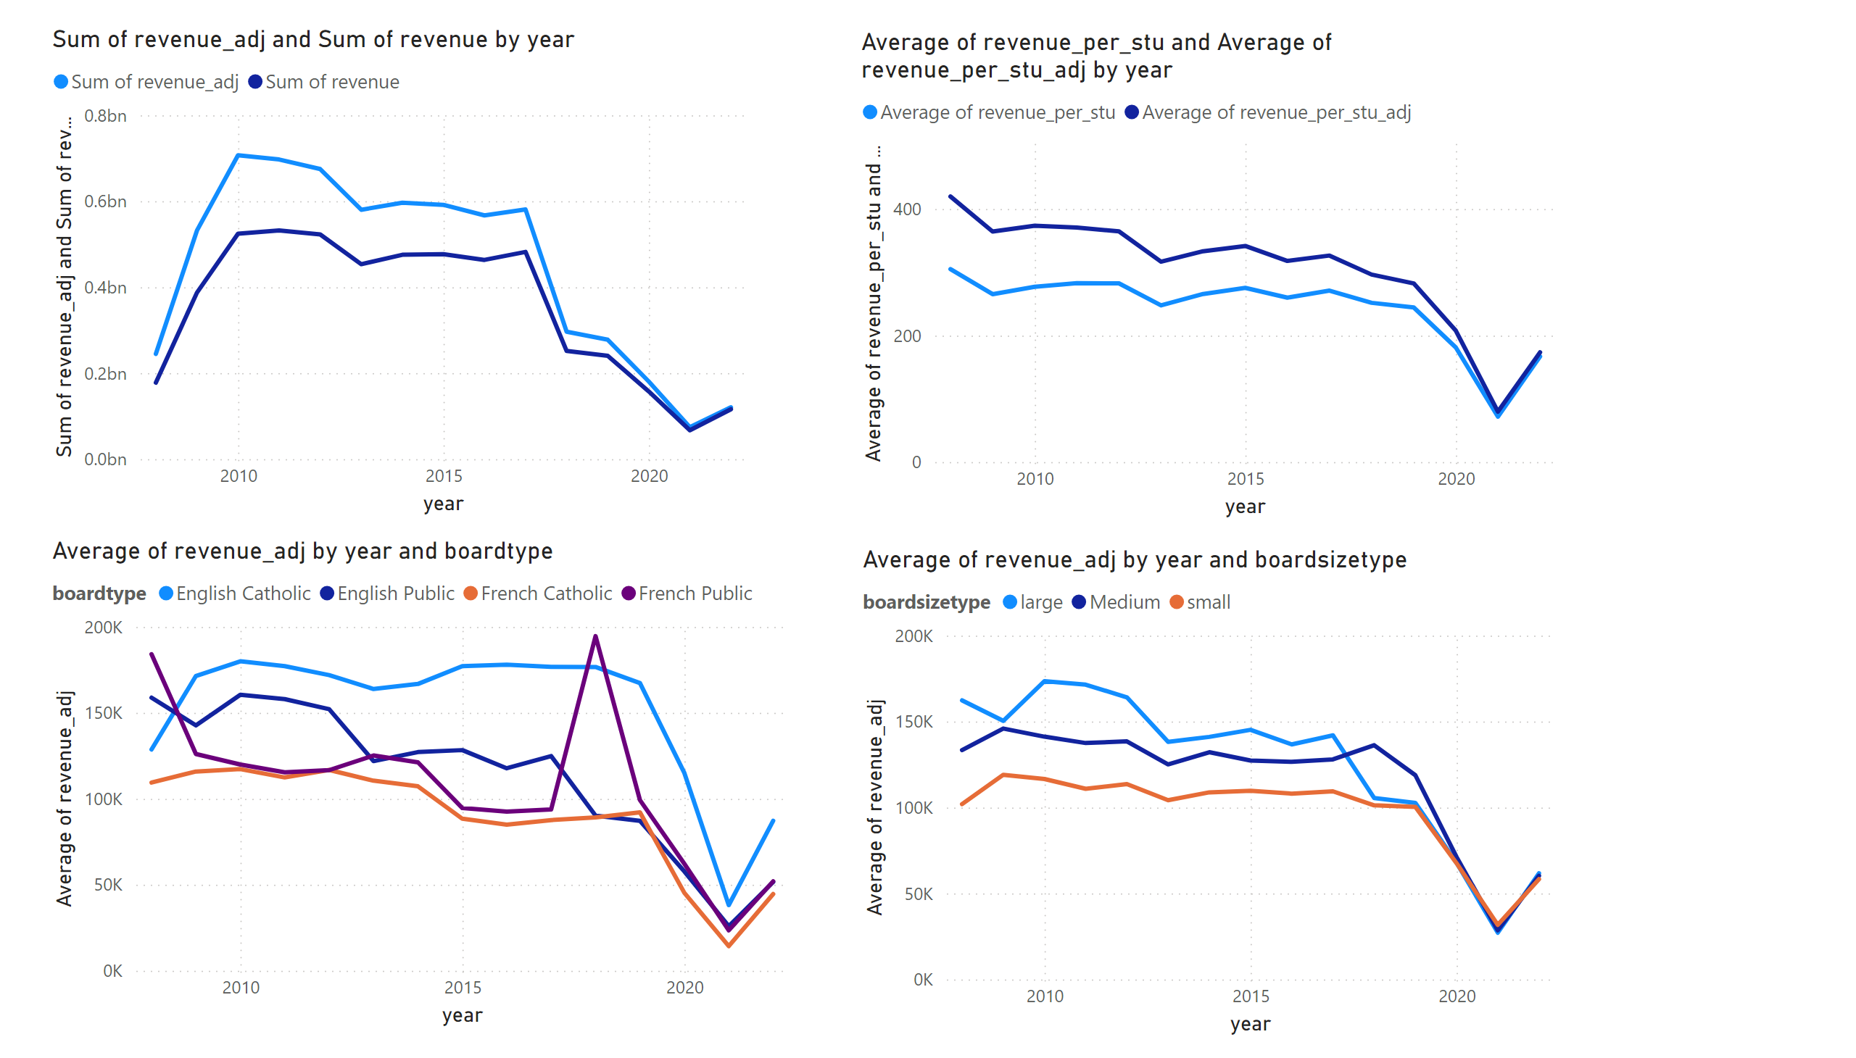
Page 1
Notes:
lineChart
No alt text provided
lineChart
No alt text provided
lineChart
No alt text provided
lineChart
No alt text provided

Slide 3
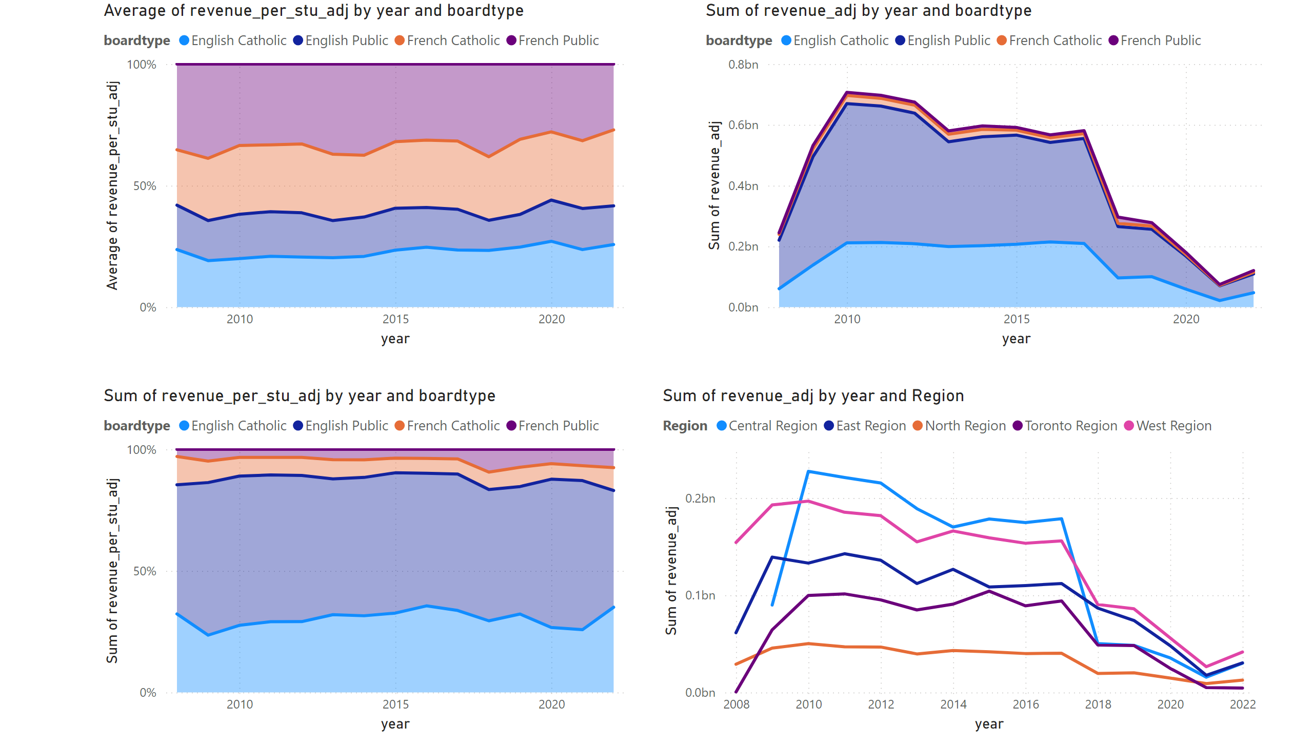
Page 2
Notes:
lineChart
No alt text provided
hundredPercentStackedAreaChart
No alt text provided
stackedAreaChart
No alt text provided
hundredPercentStackedAreaChart
No alt text provided

Slide 4
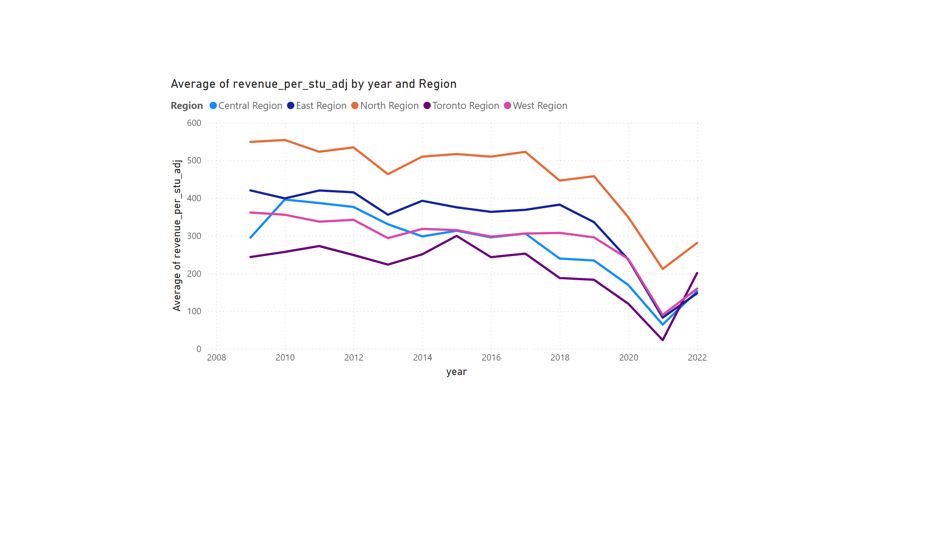
Page 3
Notes:
lineChart
No alt text provided

Slide 5
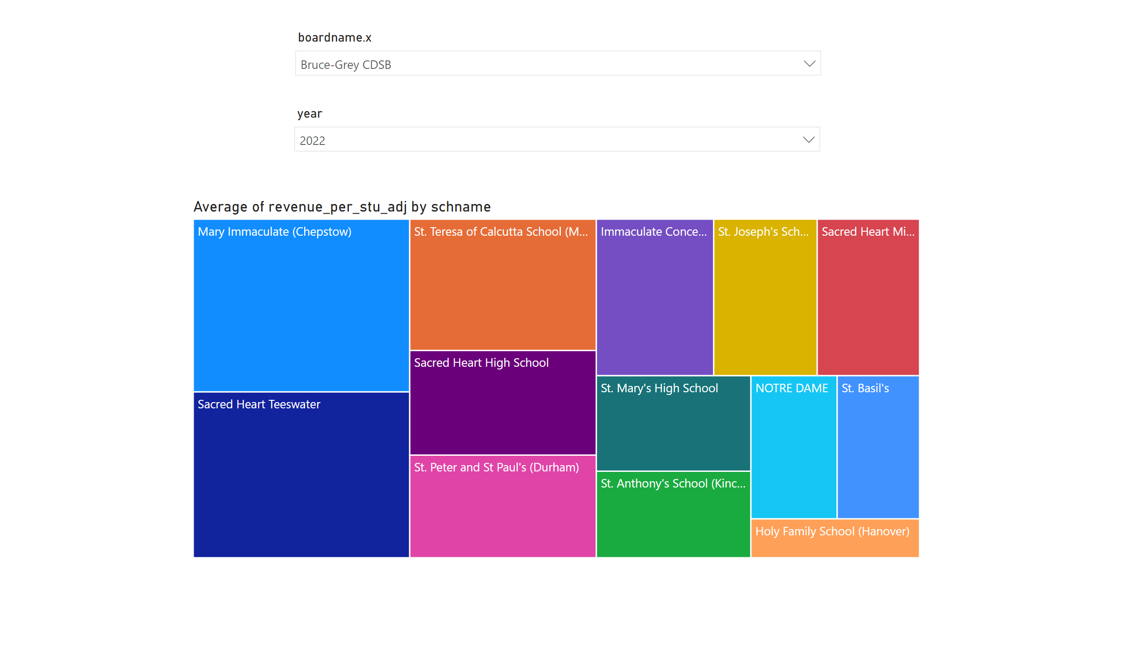
Page 4
Notes:
slicer
No alt text provided
treemap
No alt text provided
slicer
No alt text provided

Slide 6
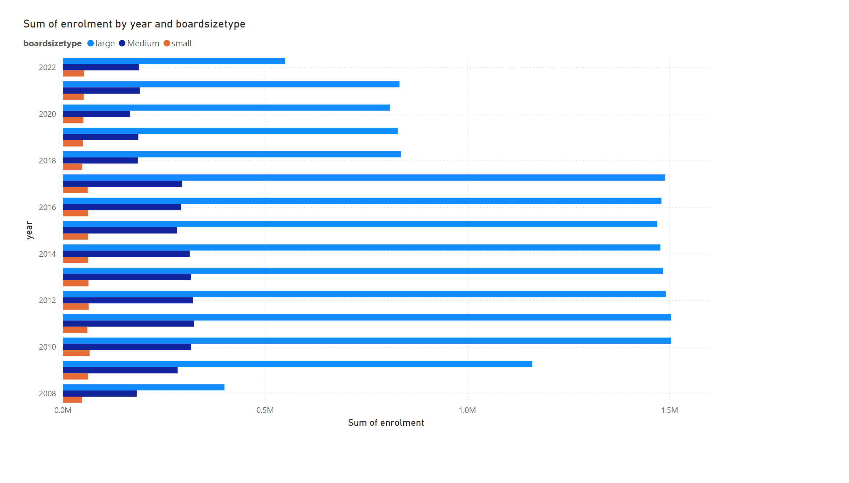
Page 5
Notes:
clusteredBarChart
No alt text provided

Slide 7
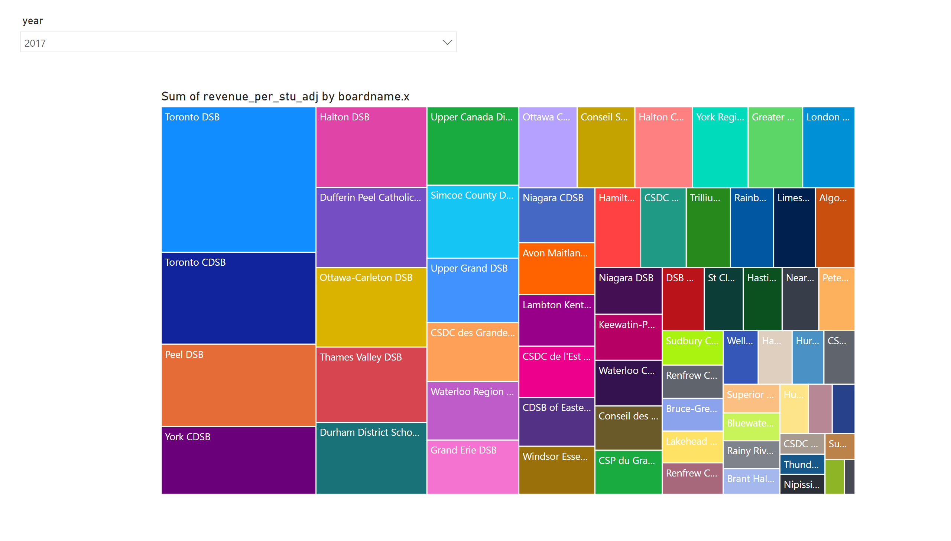
Page 6
Notes:
slicer
No alt text provided
treemap
No alt text provided

